Slide 1
Final Project Review F15.F2
Jobin Murickan
Leslie Rice

Slide 2
Part 1

Slide 3
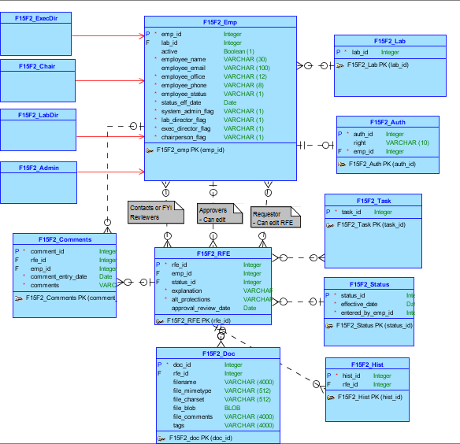
Conceptual Model

Slide 4
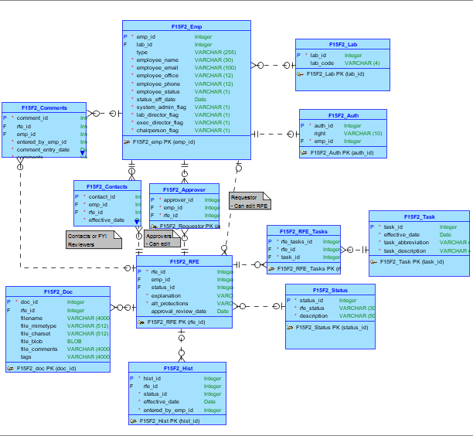
Logical Model

Slide 5
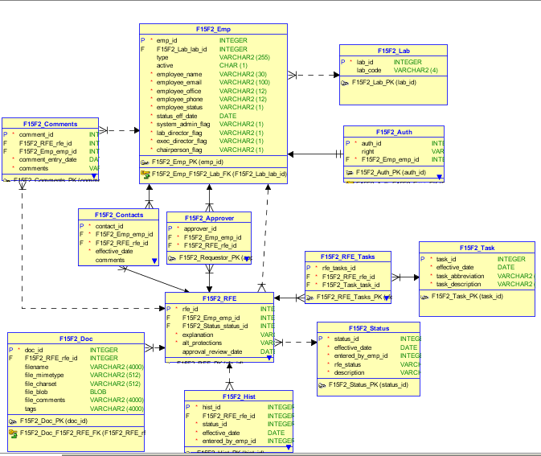
Relational Model

Slide 6
Apex Application
https://apex.oracle.com/pls/apex/f?p=15087:1:117313384431222:::::

Slide 7
Part 2

Slide 8
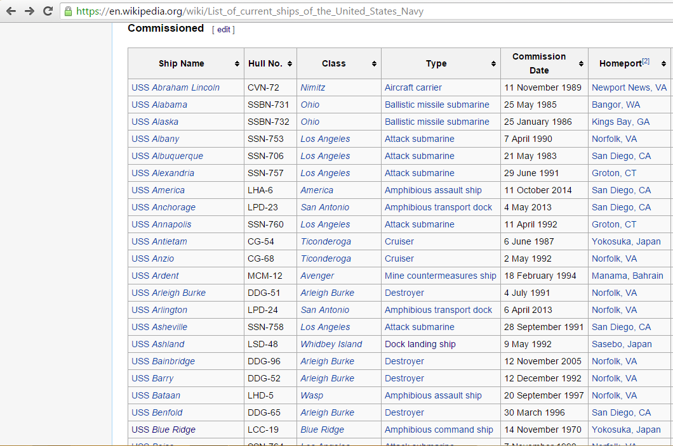
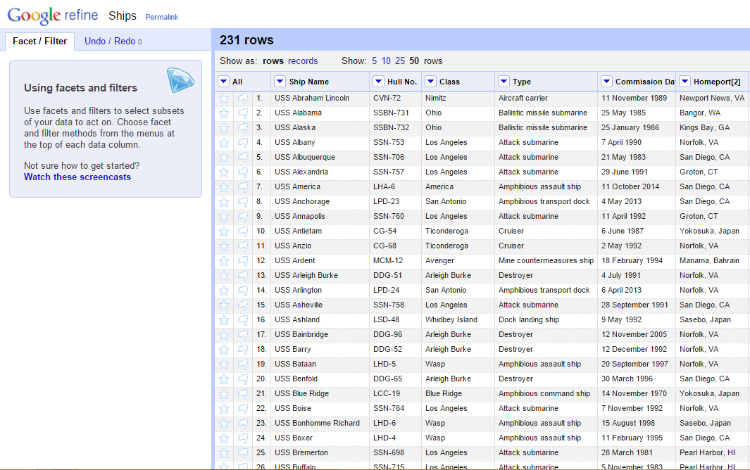
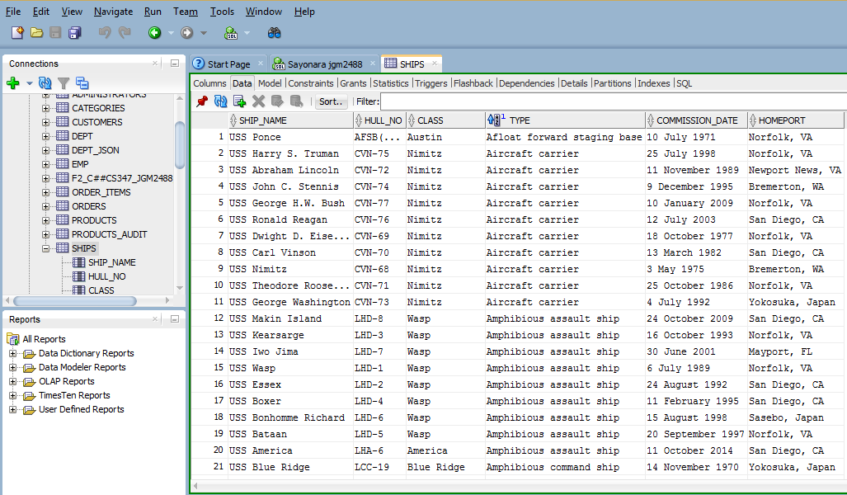

Slide 9
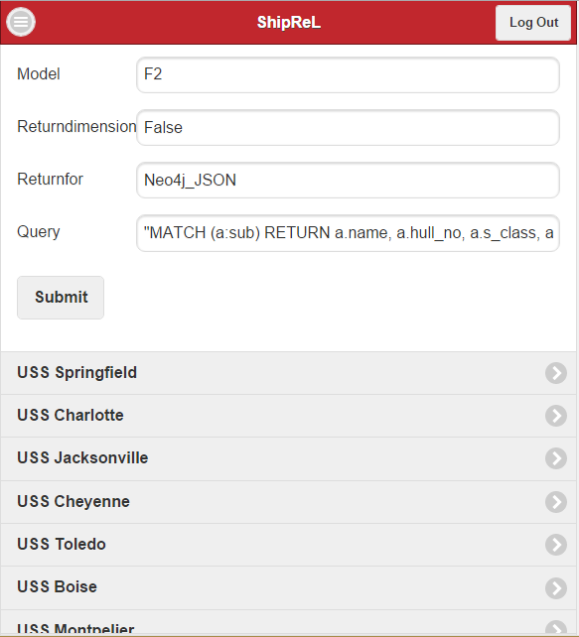
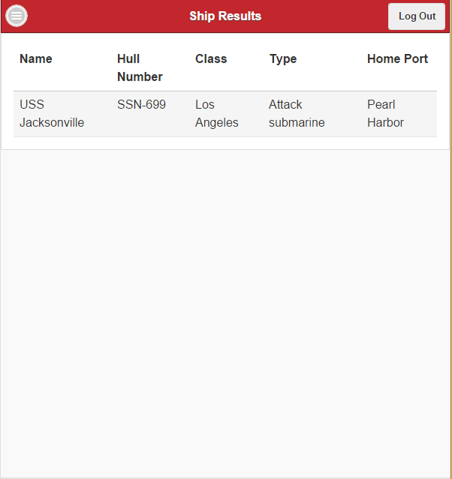

Slide 10
Github
https://github.com/leslierice/F15F2_RFE

